Slide 1
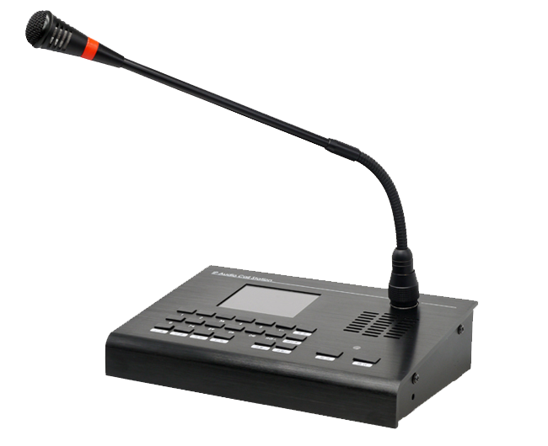
IP Network Call Station IPM-20
Features:
Professional IP Call Station to control and make announcement to all devices in the system.
Adopt high-speed industrial grade chip, startup in less than 1s
Support zone paging, and the red indicator will light up when talking
Built-in speaker for monitoring and intercom
With audio output for external active speaker
With audio input for external audio source to target terminals
Support offline talkback (without server)
Specification:
Network Protocol | IP, ARP, ICMP, DHCP, UDP, DNS, IGMP | Operating Temp. | 0~65°C
Interface | 10/100Base-TX，RJ45 | Screen | TFT 2.8” LCD
Frequency & Sampling Rate | 8kHz-32 kHz, 16 bit | Power Supply | DC 12V
Decoding | MPEG,ADPC | Dimension | 210 x 145 x 55 mm
Frequency Range | 70Hz～12.5KHz

Slide 2
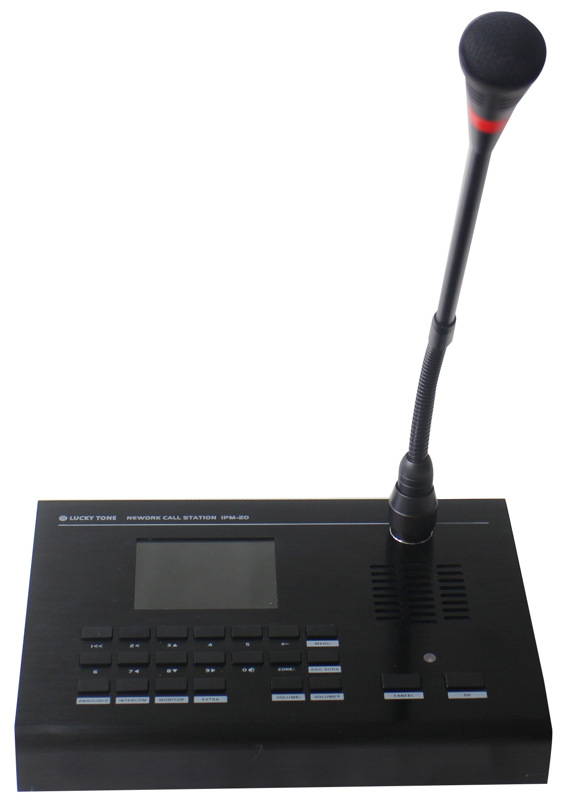
Gooseneck
Microphone
Indication Area
Built-in Speaker
Power Indicator
Power Input
Line In/Out
RJ45 Port
Power Switch
Relay Connector
Button Control Area

Slide 3
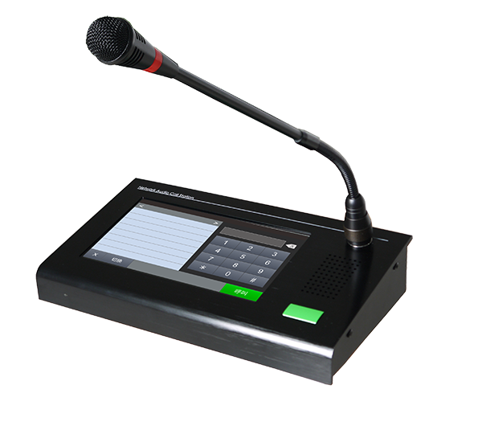
IP Network Call Station IPM-30
Features:
Professional IP Call Station to control and make announcement to all devices in the system.
Adopt high-speed industrial grade chip, startup in less than 1s
Support zone paging, and the red indicator will light up when talking
Built-in speaker for monitoring and intercom
With audio output for external active speaker
With audio input for external audio source to target terminals
Support offline talkback (without server)
Touch screen design and more interface for better user experience
Specification:
Network Protocol | IP, ARP, ICMP, DHCP, UDP, DNS, IGMP | Operating Temp. | 0~65°C
Interface | 10/100Base-TX，RJ45 | Screen | TFT 2.8” LCD
Frequency & Sampling Rate | 8kHz-32 kHz, 16 bit | Power Supply | DC 12V
Decoding | MPEG,ADPC | Dimension | 210 x 145 x 55 mm
Frequency Range | 70Hz～12.5KHz

Slide 4
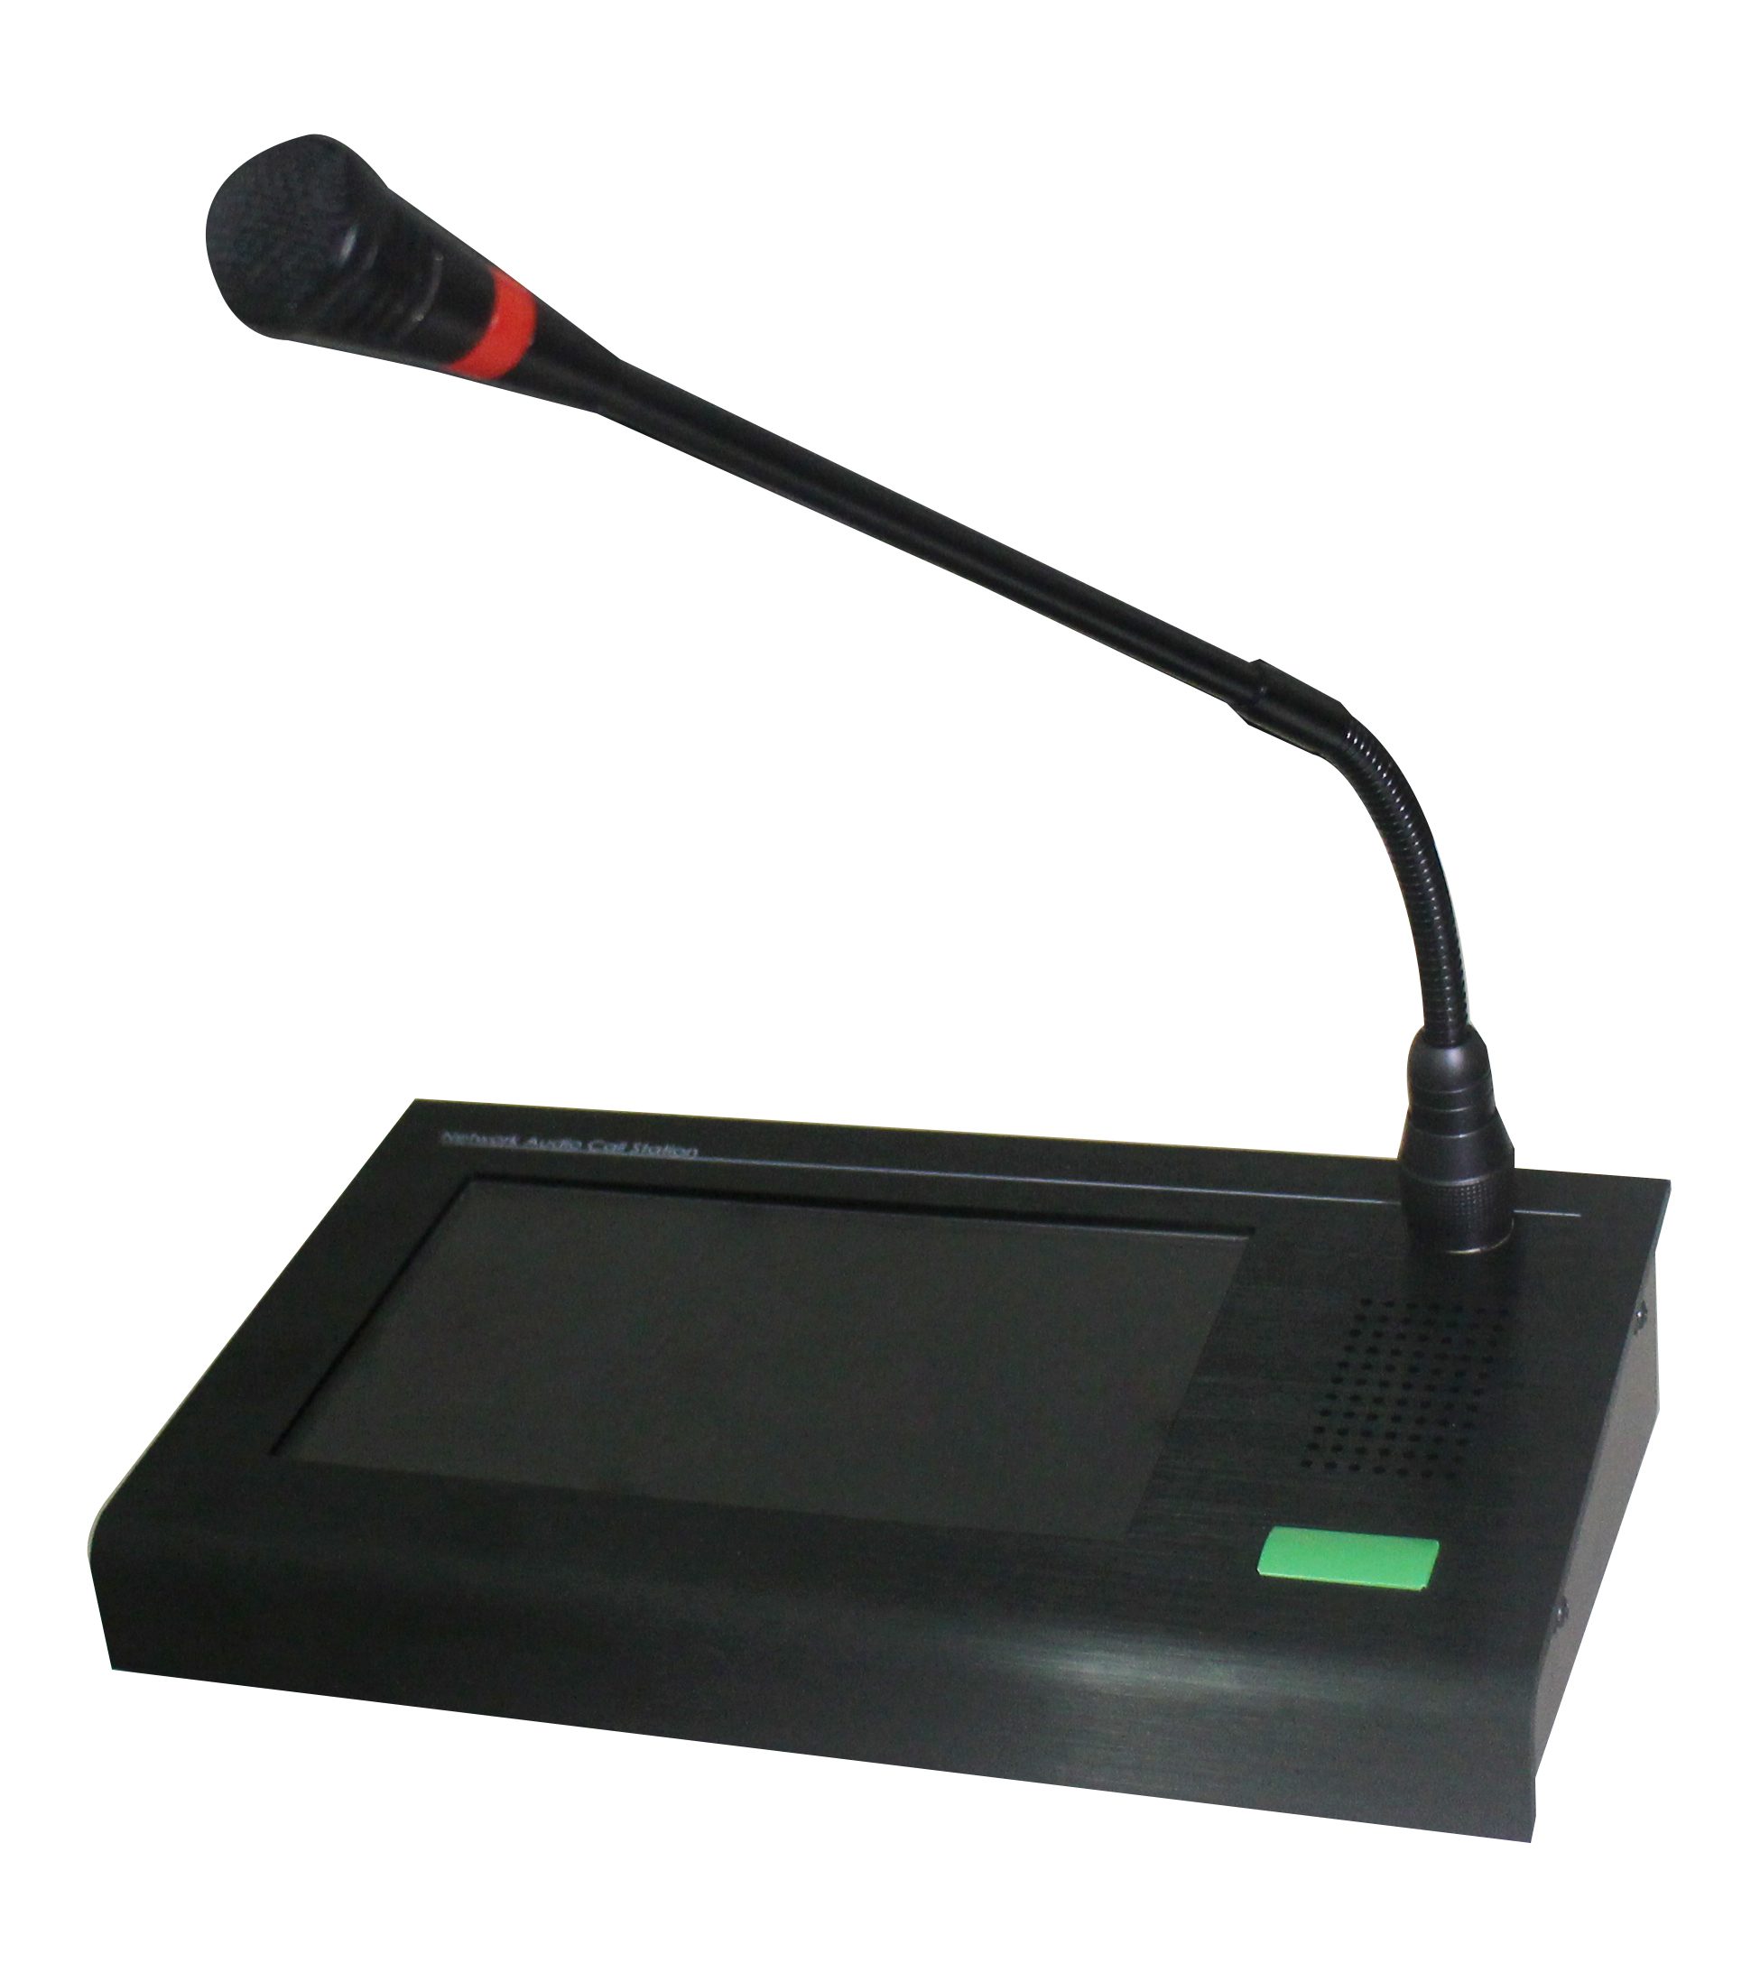
Line In/Out
RJ45 Port
Power Switch
TF Card Slot
(Reserved)
Power Input
Relay
Connector

Slide 5
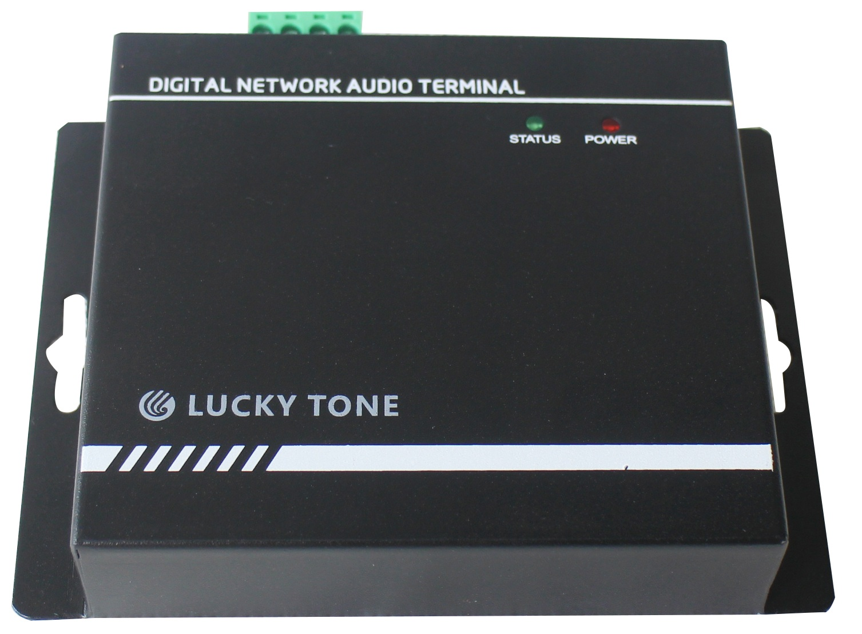
IP Network Audio Terminal IPT-215
Features:
This network terminal with built-in digital amplifier2*15 at high quality sound
Empowered by high-speed dual-core (ARM + DSP) chip of industrial grade, startup in less than 1s
Compact in Size and easy to install
Support MP3, WMA, WAV and more decoding
With a standard RJ45 network interface and supports online firmware upgrade from long distance
Specification
Network Protocol | IP, ARP, ICMP, DHCP, UDP, DNS, IGMP | Operating Temp. | 0~65°C
Interface | 10/100Base-TX, RJ45 | Power Consumption | Less than 300mW
RMS Power | 2 x 15W | Power Supply | DC 24V
Decoding | MPEG,ADPC | Product Size | 133 x 100 x 26 mm
MIC Frequency Range | 70Hz～12.5KHz

Slide 6
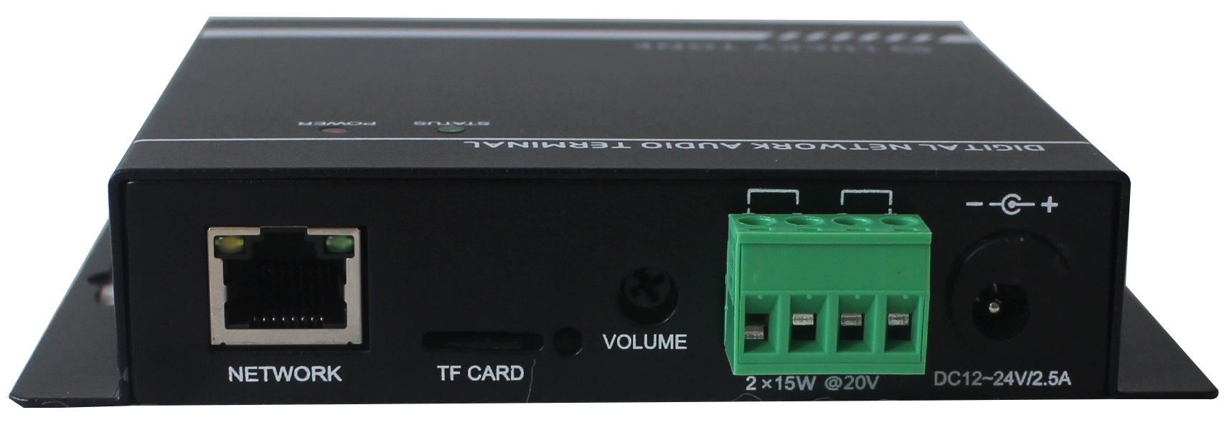
Power Supply (Adaptor)
RJ45 Port
Reserved TF Card Slot
Speaker Output

Slide 7
IP Ceiling Speaker IPC-615
IP Ceiling Speaker with PoE IPC-615POE
Features:
Support MP3, WMA, WAV and more decoding
With a standard RJ45 network interface and supports online firmware upgrade from long distance
This network ceiling loudspeaker integrated with network audio decoding, digital amplifier
Empowered by high-speed dual-core (ARM + DSP) chip of industrial grade, startup in less than 1s
Metal enclosure with fire dome
Specification
Network Protocol | TCP/UDP | Frequency Response | 100Hz～18KHz
Interface | 10/100Base-TX, RJ45 | Installation | In Ceiling
Max. SPL | 96dB | Enclosure Material | Metal
Decoding | MP3/WMA/WAV | Power Supply | DC 24V
Rated Power | 15W | Product Size | Dia. 200 x 90 mm

Slide 8
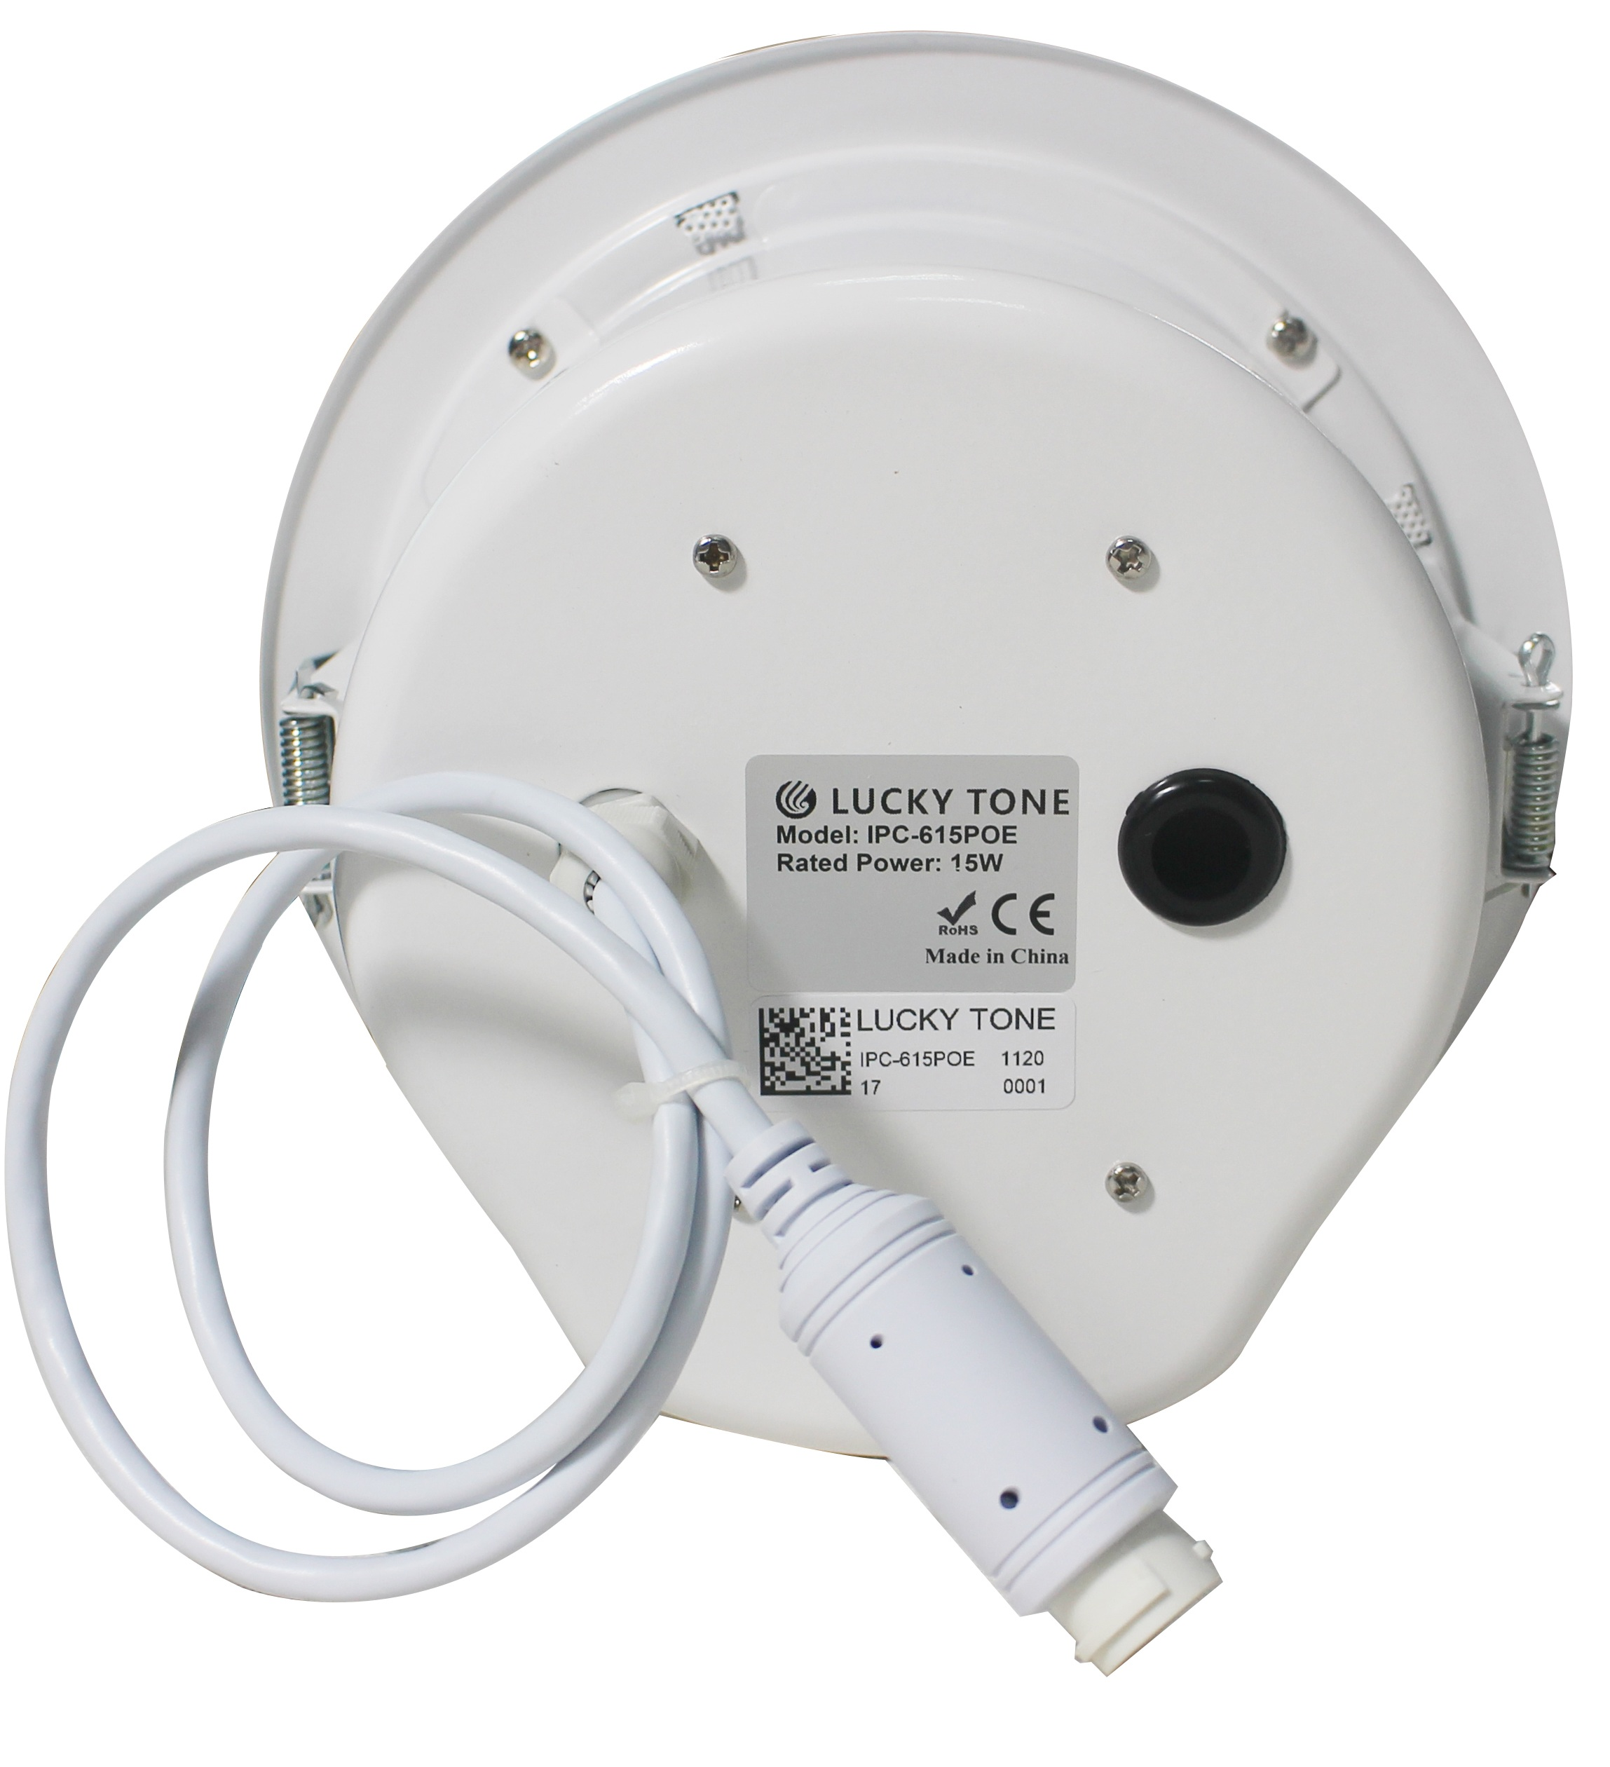
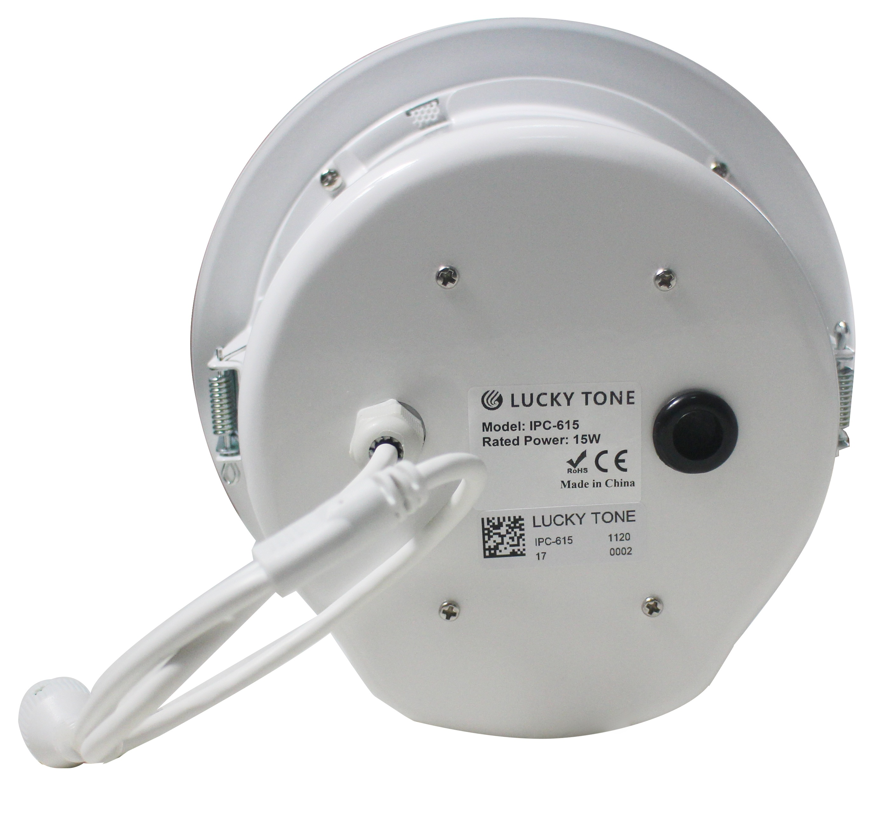
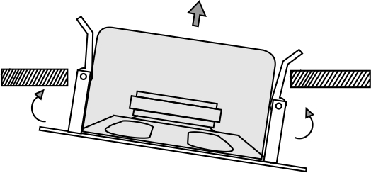
IPC-615POE rear
IPC-615 rear
Connect to *SWITCH HUB with PoE power supply
For DC 24V power adaptor
Connect to switch hub by Cat.5 cable
* OUTPUT POWER OF EACH PORT IS REQUIRED TO BE 30W OR ABOVE
Installation:
1. Cut a hole at Dia.175mm in the ceiling
2. After wiring, lift the clips of the speaker
3. Fix the speaker inside the hole carefully

Slide 9
IP Wall Speaker IPW-430
IP Wall Speaker with PoE IPW-415POE
Features:
The network wall loudspeaker integrated with network audio decoding, digital amplifier
Empowered by high-speed dual-core (ARM + DSP) chip of industrial grade, startup in less than 1s
IP55 water-proof, good for both in and outdoor application
Support MP3, WMA, WAV and more decoding
With a standard RJ45 network interface and supports online firmware upgrade from long distance
Specification
Network Protocol | TCP/UDP | Frequency Response | 80Hz～20KHz
Interface | 10/100Base-TX, RJ45 | Installation | Wall Mounted
Max. SPL | 101dB | Enclosure Material | ABS
Decoding | MP3/WMA/WAV | Power Supply | DC 24V
Rated Power | 30W / 15W (for PoE version only) | Product Size | 296 x 196 x 157 mm

Slide 10
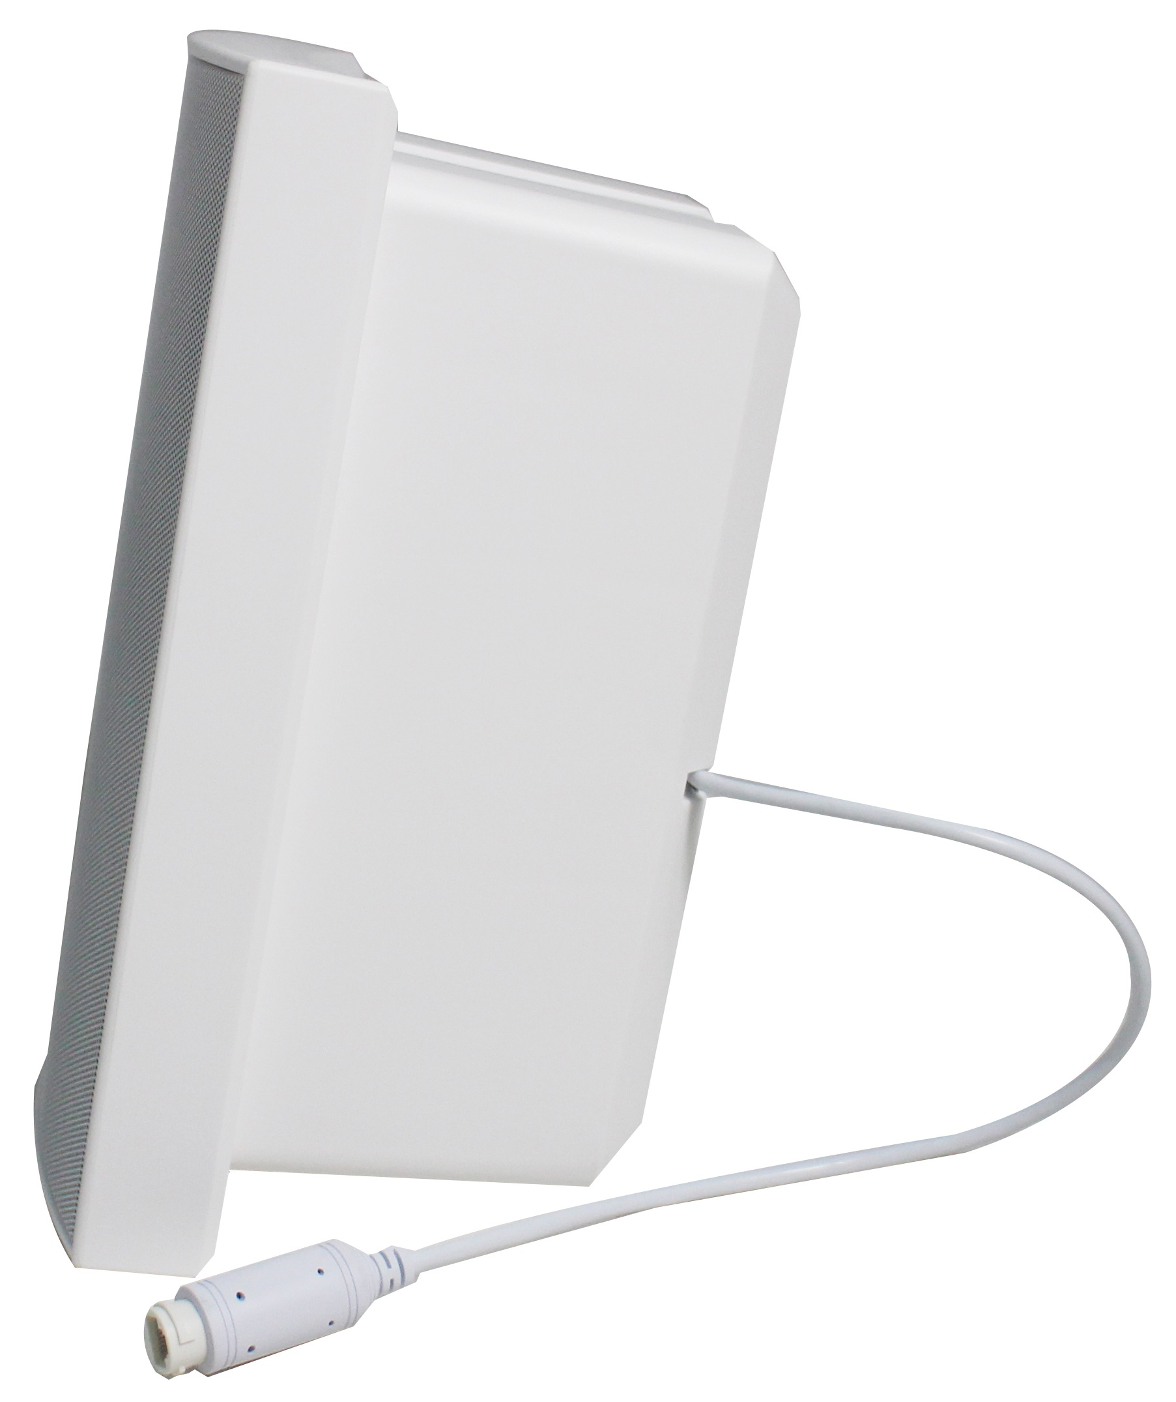
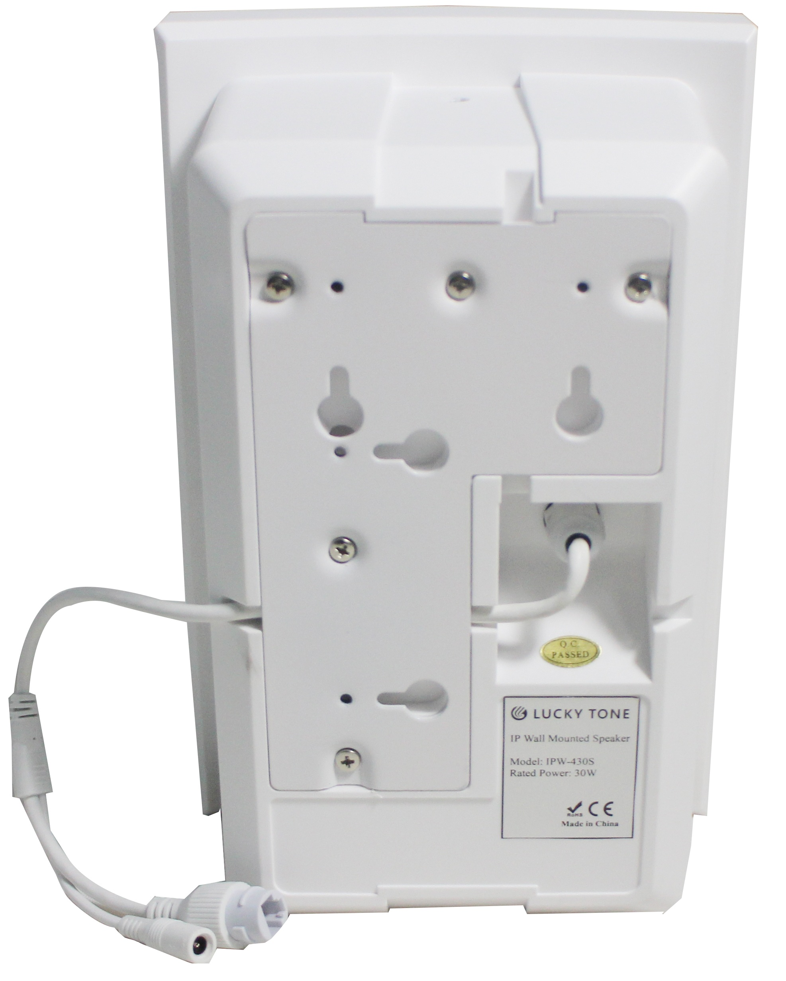
IPW-430 REAR VIEW
IPW-415POE SIDE VIEW
Connect to *SWITCH HUB
with PoE power supply
Connect to switch hub by Cat.5 cable
For DC 24V power adaptor
* OUTPUT POWER OF EACH PORT IS REQUIRED TO BE 30W OR ABOVE
Product Size:

Slide 11
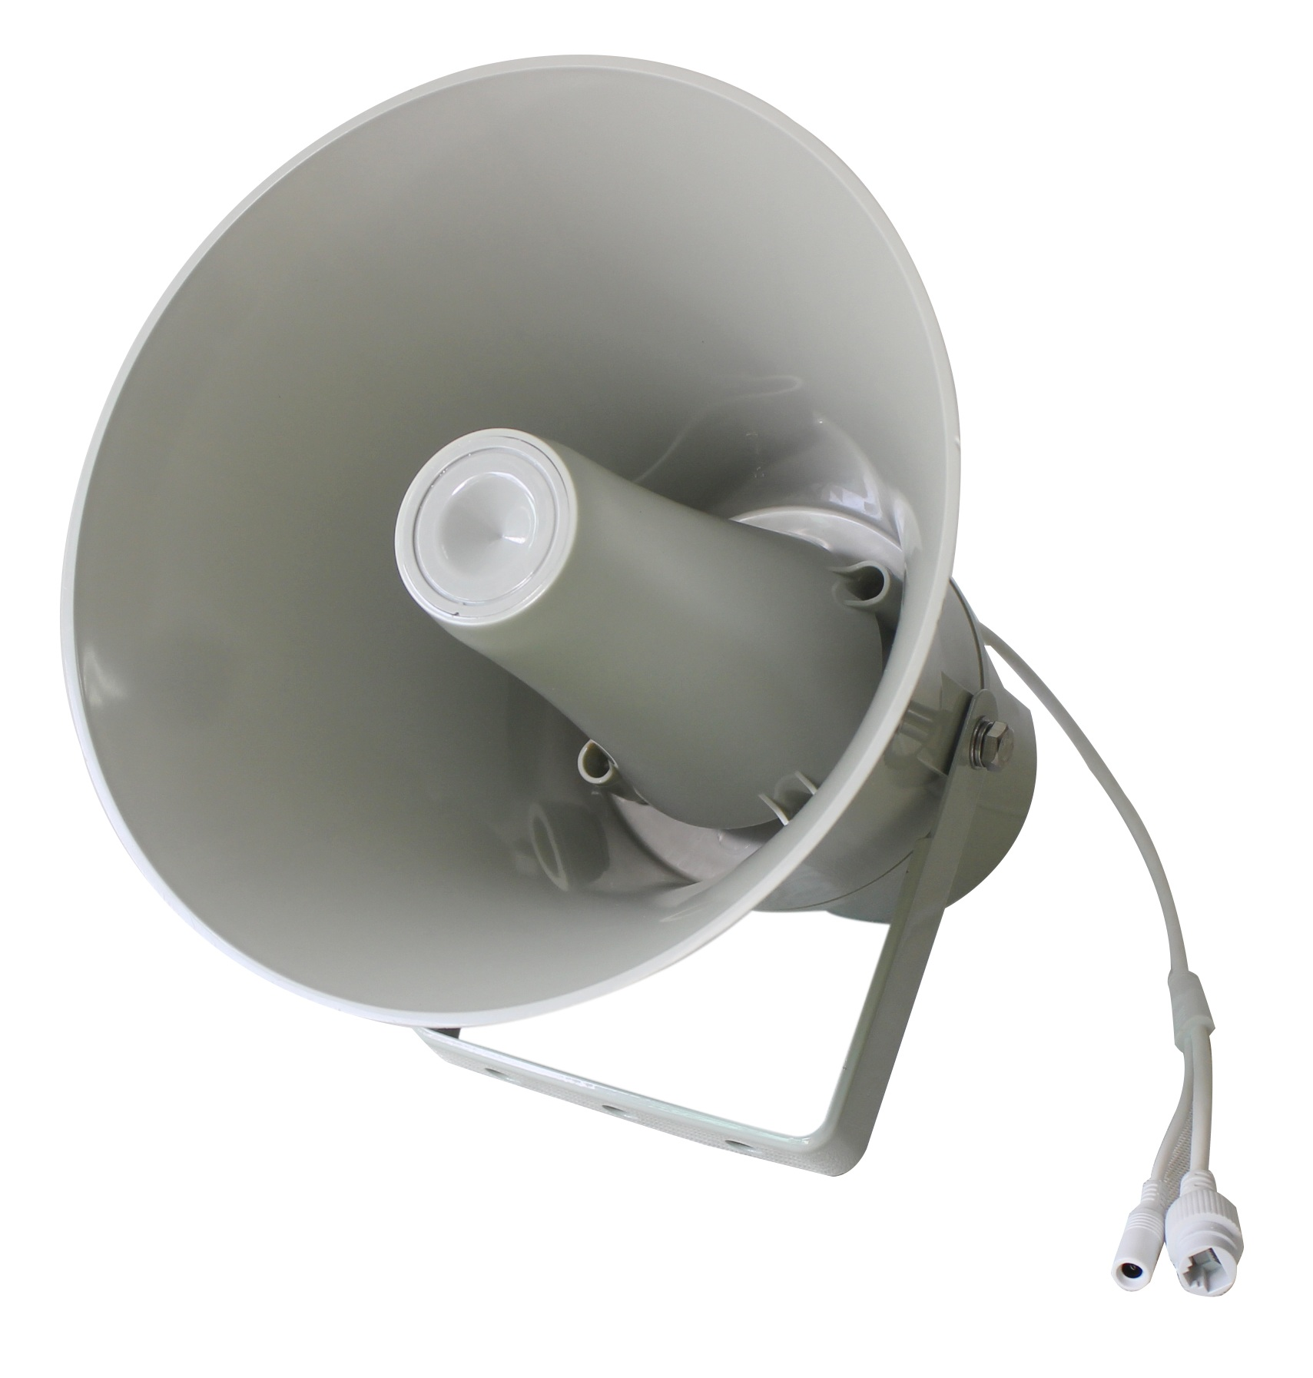
IP Horn Speaker IPH-15 / IPH-30
IP Horn Speaker with PoE IPH-15POE
Features:
The network horn loudspeaker integrated with network audio decoding, digital amplifier
Empowered by high-speed dual-core (ARM + DSP) chip of industrial grade, startup in less than 1s
IP67 water-proof horn speaker available at 15W and 30W
Support MP3, WMA, WAV and more decoding
With a standard RJ45 network interface and supports online firmware upgrade from long distance
Specification | IPH-15 & IPH-15POE | IPH-30
Network Protocol | TCP/UDP
Interface | 10/100Base-TX, RJ45
Decoding | MP3/WMA/WAV
Rated Power | 15W | 30W
Max. SPL | 113dB | 120dB
Frequency Response | 300Hz~8KHz | 350Hz~8KHz
Enclosure Material | ABS
Product Size | Dia. 200 x 230mm | Dia. 246 x 292mm

Slide 12
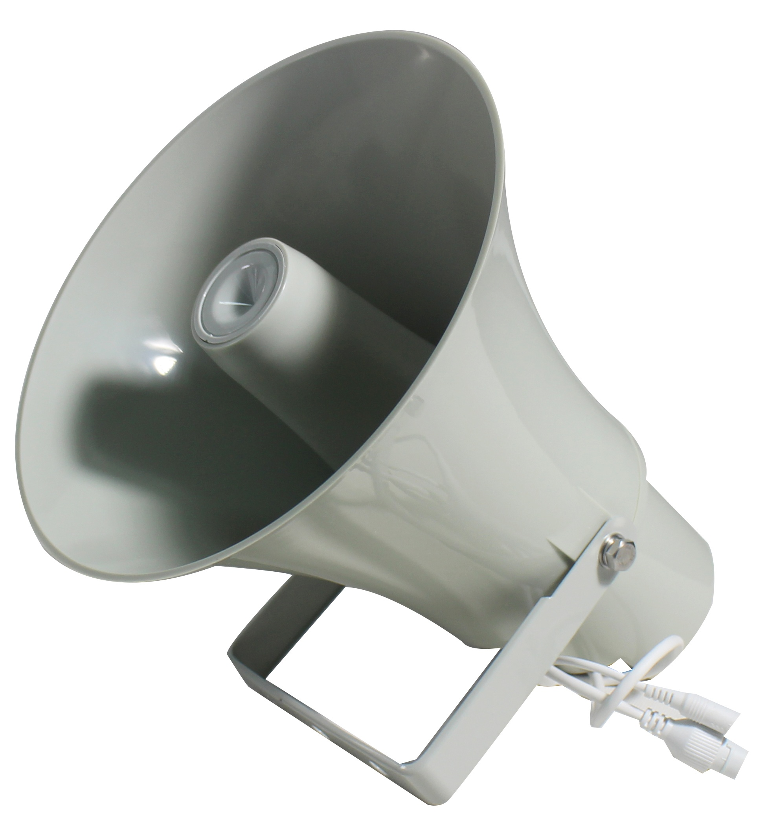
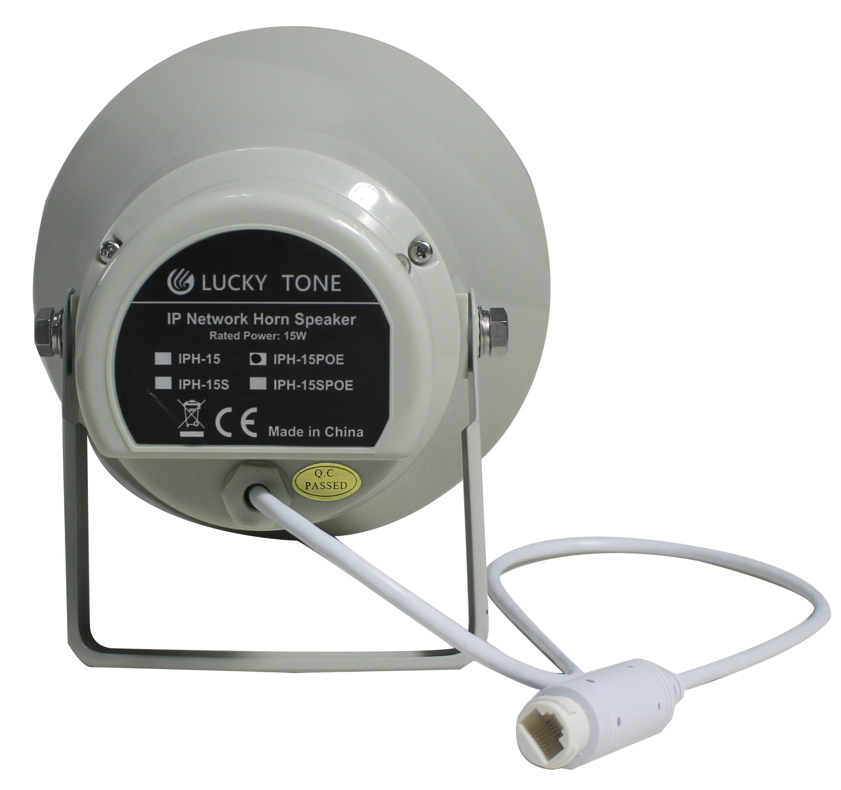
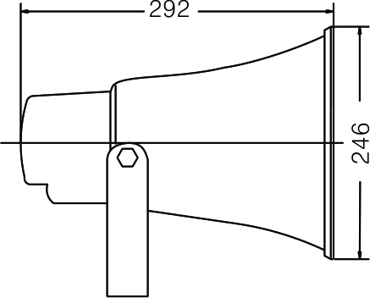
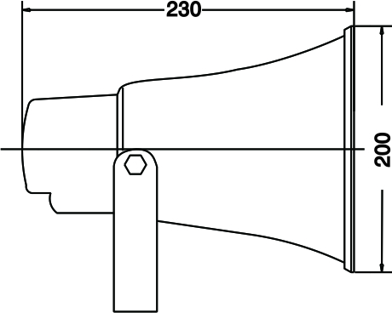
IPH-15 Profile
IPH-15POE Rear
For DC 24V power adaptor
Connect to *SWITCH HUB
with PoE power supply
Connect to switch hub via Cat.5 cable
* OUTPUT POWER OF EACH PORT IS REQUIRED TO BE 30W OR ABOVE
Product Size:
Mounting:
Wiring as mentioned above
Screw up through the holes on bracket
Adjust the speaker to desired direction then tight up.
IPH-30
IPH-15 or IPH-15POE

